Slide 1
Lecture 11
Dr. Mohammed Abdul Baset
Examples of Titration Curves
2) Precipitatometric (Precipitation) titrations
Analyte is titrated with a standard solution of a precipitating agent in accordance with defined reaction stoichiometry. Detection of the endpoint (at completion of the precipitation) is usually by either the appearance of excess titrant or the disappearance of the reactant.
General Principles
The major precipitation reaction used is that of silver with a range of anions. These anions include:
56

Slide 2
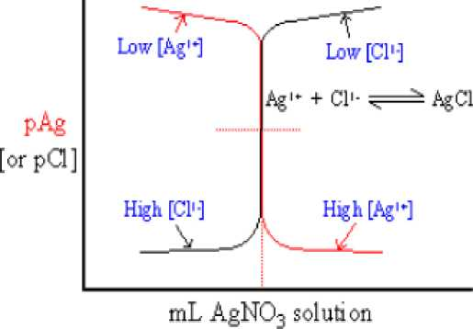
• Chloride
• Bromide
• Iodide
• Thiocyanate
Titrations involving silver are termed argentometric, from the old name for silver, argentum. The reaction rates for the silver salt precipitation is rapid. The reaction ratio is 1:1 and silver salts formed are generally quite insoluble.
Requirements
1. The precipitate formation is stoichiometric.
2. To allow the titrant to be added quickly, the equilibrium between the precipitate and its ions in solution much be attained rapidly. A slow attainment of equilibrium will cause over titration.
3. The precipitate must be of low solubility in the solution. This is indicated by small equilibrium constant (Ksp).
4. A method to detect the stoichiometric point of the titration must be available. Although a number of indicators are available, in general, the best method for detecting the end point in precipitation titration is by an instrumental technique.
Factors influencing the solubility
1. Temperature
2. Solvent properties
3. Common ions
4. Ionic activity
5. pH
6. Hydrolysis
7. Metal hydroxyde
8. Complex compound formation
Titration Curves for Argentometric Methods
Plots of titration curves are normally sigmoidal curves consisting of pAg (or pAnalyte) versus volume of AgNO3 solution added. The points on the curve can be calculated, given the analyte concentration, AgNO3concentration and the appropriate Ksp.
Example: Titration of chloride with silver.
57

Slide 3

Observations about Argentometric Titrations
High reagent concentrations give sharper, more dramatic equivalence point changes in pAg and better endpoints. The smaller the Kp, the more complete the precipitation reaction and the sharper the equivalence region changes. Both K_{sp} and the reagent concentrations affect the choice and use of an endpoint indicator.
Endpoint Indicators for Argentometric Titrations
• Indicators for argentometric titrations are selected to produce a color change at or near the equivalence point.
• Normally the indicator is selected to react with the added titrating agent, not the analyte. If A is the analyte, R the titrating agent and In is the indicator.
To make the indicator change color, excess R must be added. Obviously, the smaller the excess added to cause the color change, the smaller the end point error. This means that the indicator should give large color changes at very low concentrations.
End Point Determination in Precipitation Titrations
Titrations with Ag⁺ are called argentometric titrations.
For argentometric titrations, three classical methods based on color indicator scan be used for end point detection:
■ Mohr titration-formation of colored precipitate at the endpoint.
■ Volhard titration-formation of a soluble, colored complex at the endpoint.
■ Fajans titration-adsorption of a colored indicator on the precipitate at the endpoint.
58

Slide 4
This interferes with the titration, the silver oxide may even precipitate before silver chromate especially where the solubility product of Ag2O is exceeded. If ammonium salts are present, the pH of the solution must not exceed pH 8 otherwise free ammonia will be produced and dissolve the silver chloride precipitate. Therefore, the halide solution should be neutralized before titration if necessary, by adding NaHCO₃ or dilute HNO₃, as the case may be.
2- Cations that give insoluble chromate e.g. barium ions: They must be absent or removed before the titration.
3- The reverse titration of silver ion with chloride ion using chromate as indicator is not feasible, the flocculated Ag2CrO4 formed initially, reacts slowly with chloride especially near the end point of the titration. However to determined silver by Mohr method, it is possible to add excess standard chloride solution and then back-titrate using the chromate indicator.
4- Titration of iodide; and of thiocyanate is not successful because silver iodide and silver thiocyanate adsorb chromate ions so strongly that a false and somewhat indistinct end point is obtained.
Use of adsorption indications (Fajan method)
This method uses an adsorption indicator such of fluorescein and eosin. The indicator adsorb onto the surface of the silver salt precipitate at the endpoint. The adsorption process causes a change in the colour of the indicator. •
• AgNO3 added to a dilute solution of NaCl, the solution becomes turbid and if other electrolytes are absent, coagulation does not occur immediately.
• The colloidal sized AgCl particles adsorb Cl⁻ and these attract sodium ions as shown in Fig below.
• Colloidal particles are electrically charged and repel each other preventing coagulation.
59

Slide 5
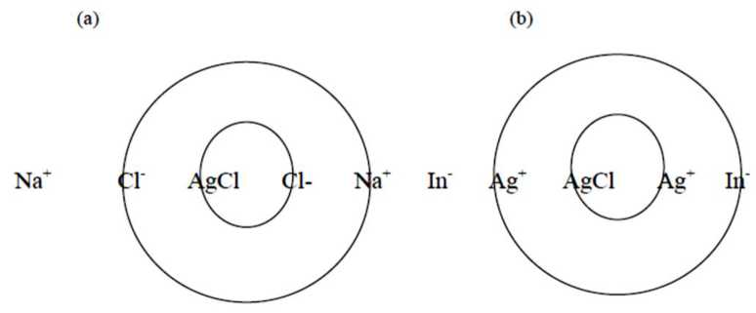
• As titration continues, the amount of chloride decreases but there is still some surface charge, which acts to repel the negatively charged indicator ion.
Figure. Colloidal silver salts (a) before endpoint and (b) after endpoint
• Immediately after endpoint there is an excess of silver ions which will adsorb onto the surface of the precipitate
• The charged surface has now changed polarity and attracts the negative indicator ion
• A colour change will be observed
• A blank titration is not required as the indicator does not react with the titrant
Limitations of Fajan’s method
• Low background levels of non-reacting ions to ensure that coagulation does not occur.
• Will not work with very low levels as there will not be enough precipitate to allow the colour change to be observed
• Method is pH dependent as the indicator must be in the ionised form
Fajan’s method can be used to titrate silver with a standard chloride solution. This is not possible in Mohr’s method since chromate added to a silver solution would immediately cause a precipitate.
Formation of a soluble coloured compound (Potassium Thiocyanate as Titrant (Volhard method)):
This method uses a back titration with potassium thiocyanate and is suitable for the determination of chlorides, bromides and iodides in acidic solutions. A known excess of silver nitrate solution is added to the sample and the excess is back titrated with standard thiocyanate solution. The titration uses iron III as the indicator. The iron III indicator works by forming the coloured complex when an excess of thiocyanate occurs. The solution must be acidic, with a concentration of about 1 M in nitric to ensure the complex formed is stable. The method is suitable for the direct determination of silver or for the indirect determination of halide ions.
For the chloride estimation, we have the following two equilibria during the titration of excess of silver ions:
60

Slide 6
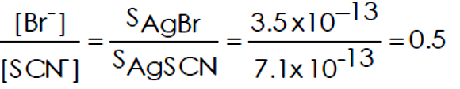

When the excess of silver has reacted, the thiocyanate may react with the silver chloride, since silver thiocyanate is the less soluble until the ratio [Cl⁻] / [SCN⁻] in the solution is 170.
AgCI + SCN⁻ —>AgSCN +CI⁻
This will take place before reaction occurs with the ferric ions in the solution and there will consequently be a considerable titration error. It is therefore absolutely necessary to prevent the reaction between the thiocyanate, and the silver chloride. This may be effected in several ways, of which the first is probably the most reliable:
a) The silver chloride is filtered off before back titration.
b) After the addition of the silver nitrate, the suspension is boiled for about 3 minutes, cooled and then titrated immediately,
c) An immiscible liquid is added to "coat" the silver chloride particles and thereby protect them from interaction with the thiocyanate. The most successful liquid is nitrobenzene.
With bromides, we have the equilibrium;
The titration error is small, and no difficulties arise in the determination of the end point. Silver iodide (S.P. 1.7 xlO-16) is less soluble than the bromide, the titration error is negligible but the ferric ion indicator should not be added until excess of silver is present, since the dissolved iodide reacts with the ferric iron.
Limitations of Argentometric titrations:
1- Reducing agents, such as, sulphur dioxide interferes by reducing the silver ions, and must be removed by previous oxidation.
2- Coloured compounds of any sort obscure the end point, which is taken as the faintest ting of colour detectable on the precipitated silver halide, or in solution, as the case may be.
3- Silver halides are sensitive to photodecomposition, and the titration should be carried out in diffused daylight, or artificial light.
4- Most cations except the alkalies and alkaline earths interfere in several ways,
61

Slide 7
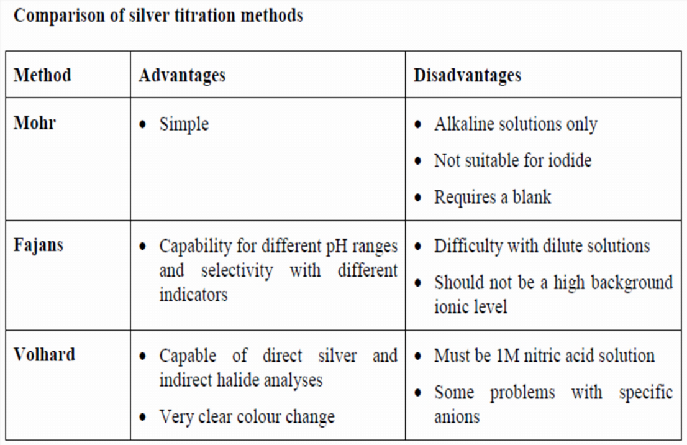
a) Some, such as Fe³⁺ form insoluble coloured hydroxide in neutral or slightly acid medium;
b) Some, such as A1³+, hydrolyse to insoluble basic salts in neutral or slightly acid solution, showing a tendency to coprecipitate chloride;
c) Hg²+ form soluble complexes with halides of the type [HgI₄]²⁻.
Comparison of silver titration methods
62

